Slide 1


Course Challenge Details

Slide 2
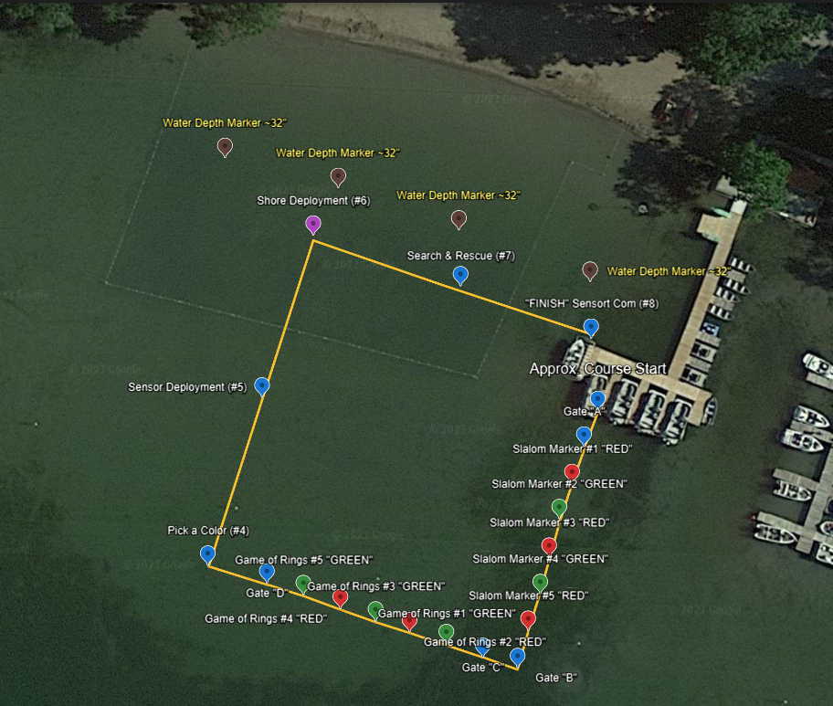
Course
Map
Google Earth

Slide 3
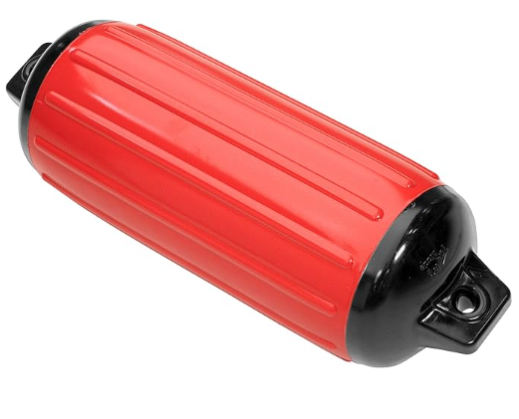
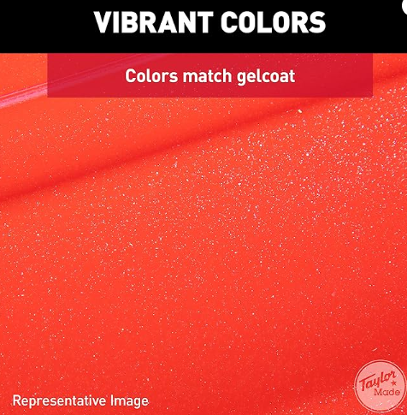
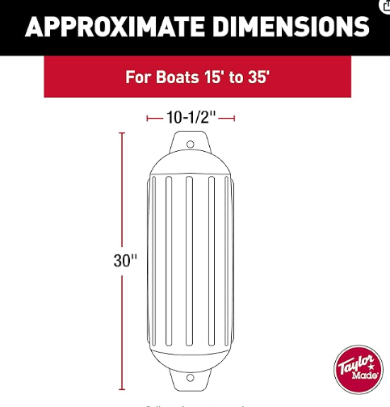

Buoy Markers
*Color Defined by Challenge
Taylor Made Products Super Gard Inflatable Vinyl Boat Fender
https://www.amazon.com/Inflatable-Double-Molded-Football-Inflation-Atlantic/dp/B000MJMQ74/ref=sr_1_25?crid=1GXGSM4SDCGK7&keywords=taylormade%2Bboat%2Bbumpers&qid=1698668009&sprefix=taylormade%2Bboat%2Bbumper%2Caps%2C84&sr=8-25&th=1&psc=1

Slide 4
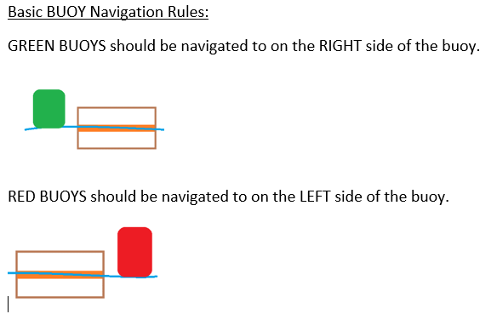

Slide 5
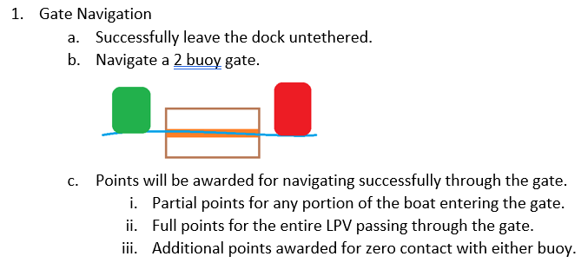
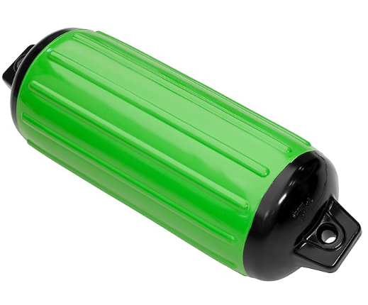
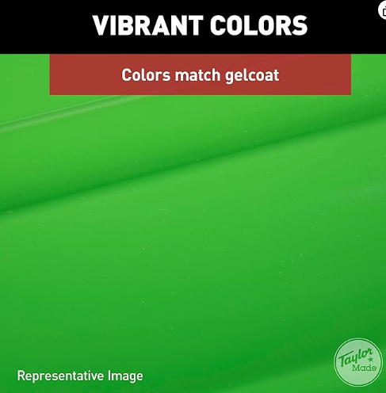
CHALLENGE #1 Gate Navigation
Lime Green
Red

Slide 6
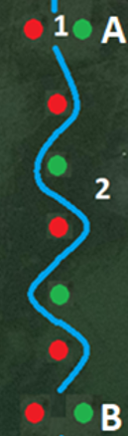
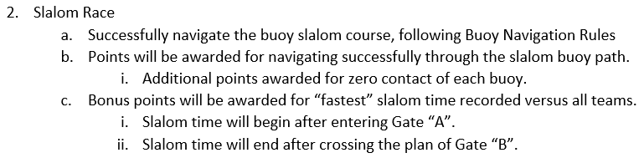
CHALLENGE #2 Slalom Race
Lime Green
Red

Slide 7
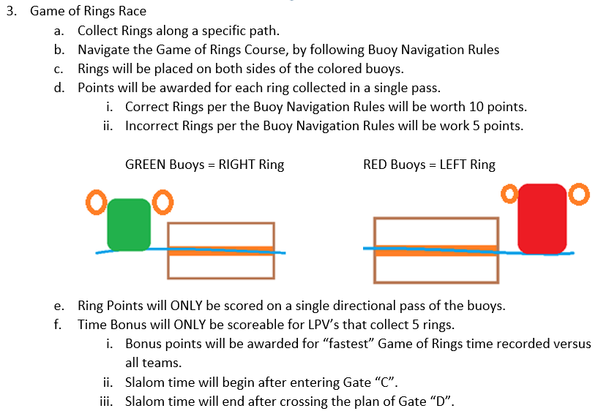
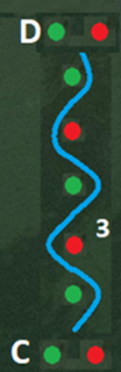
CHALLENGE #3 Game of Rings Race

Slide 8
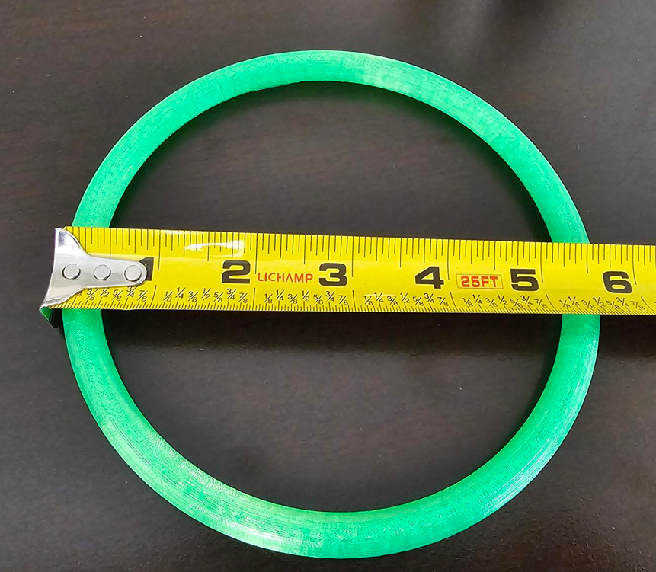
CHALLENGE #3 Game of Rings Race
Lime Green
Red
Markers for Game of Rings will be stabilized with “Sand Anchor” to prevent rotation.
Something similar to:
https://www.amazon.com/SturdyShape-Stainless-Protection-Suitable-Pontoon/dp/B0C3B5XGN1/ref=sr_1_1_sspa?keywords=boat+sand+anchor&qid=1698680847&sr=8-1-spons&sp_csd=d2lkZ2V0TmFtZT1zcF9hdGY&psc=1
PLA 3D Printed Ring
  Red Rings on Red Marker
  Green Rings on Green Marker
5.75” OD
3/8” Cross-section Width

Slide 9
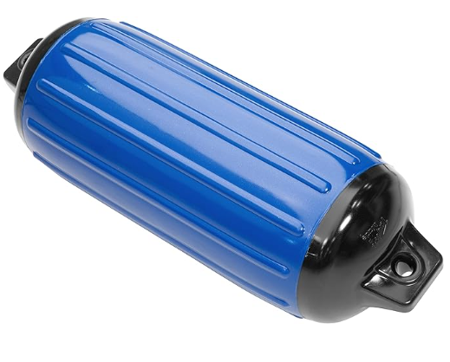
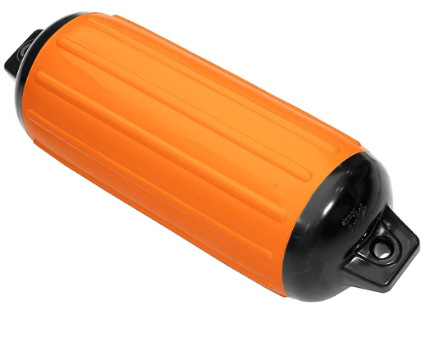
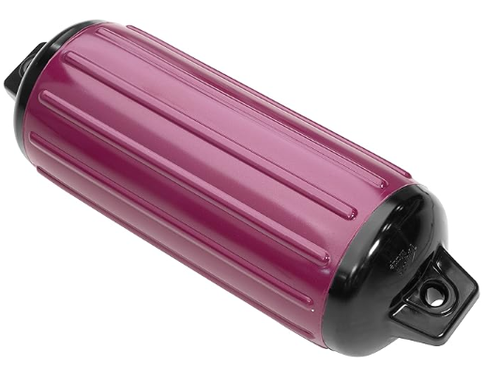
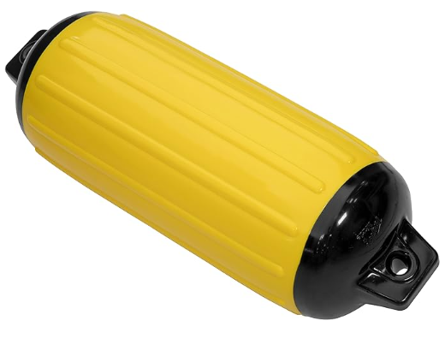
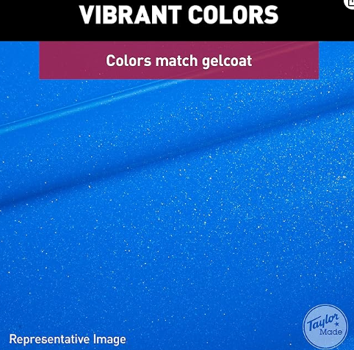
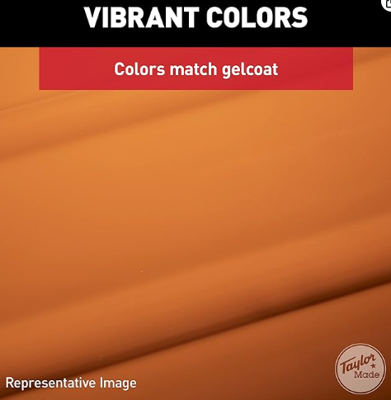
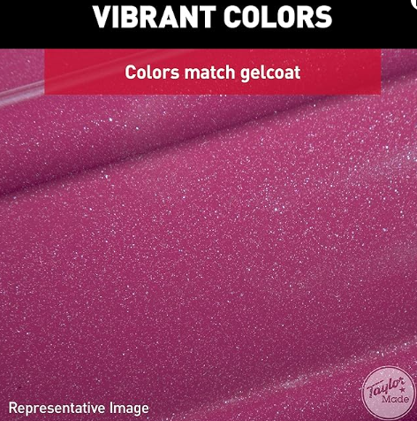
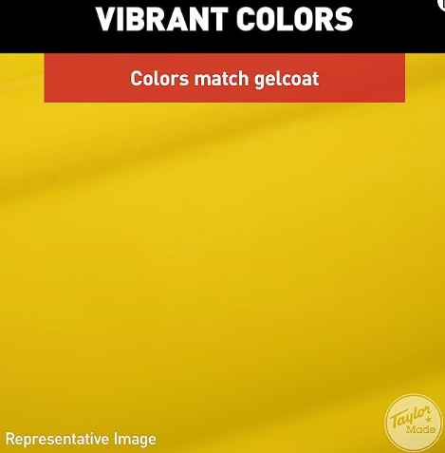
CHALLENGE #4 Pick a Color
Navigate to a specific-colored buoy
Contact the buoy with the LPV to receive points
Teams can define the colored buoy that their LPV will seek & contact
Additional points can be earned by having judge randomly select the color for the team

Slide 10
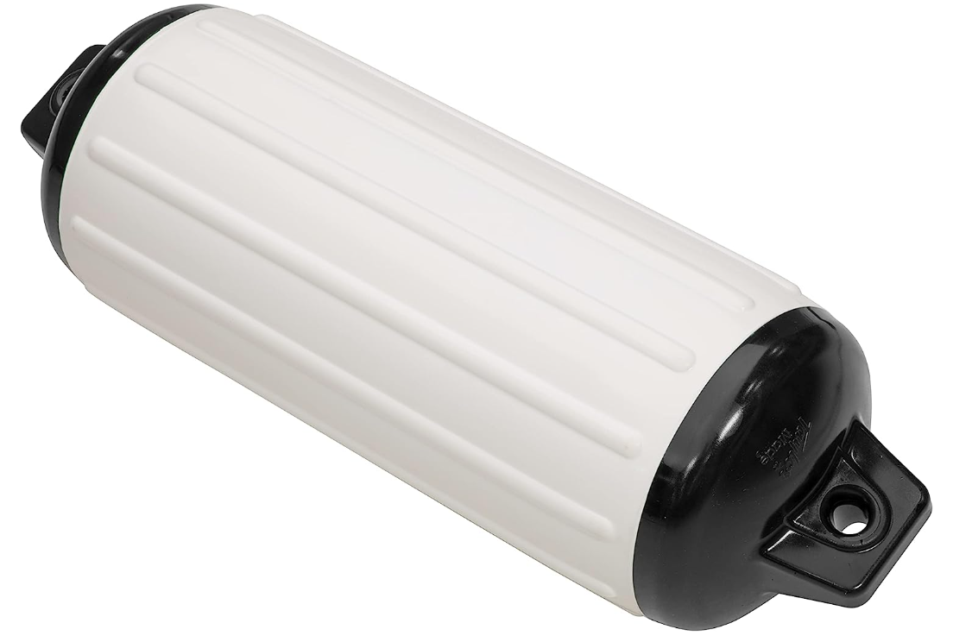
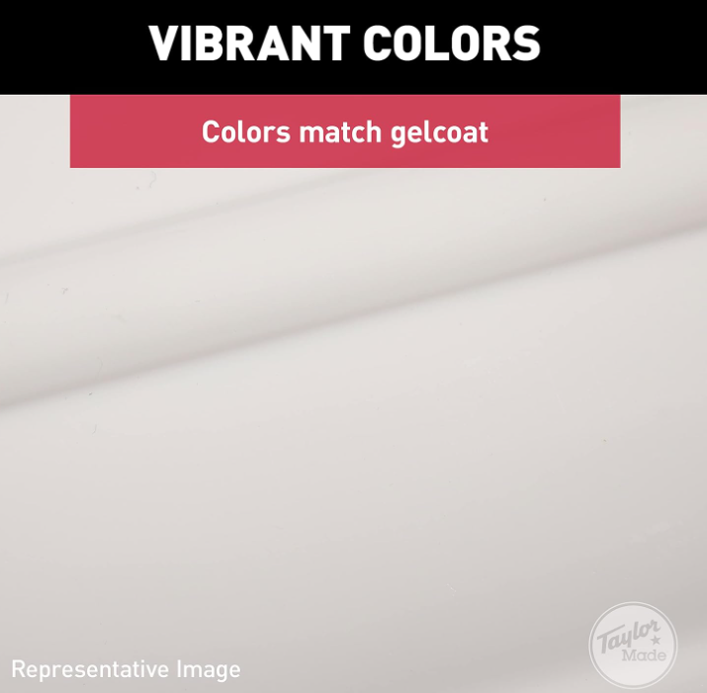
CHALLENGE #5 Sensor Deployment
Teams will be able to define a deployable sensor
Navigate to the “Zebra” buoy
  2” wide black electrical tape will be “spiral” wound around the white buoy
Deploy the sensor
  Sensor must not be tethered to the LPV
Sensor upon initial deployment must be with 6’ radius of Zebra Buoy
Sensor must stay with in this defined halo for duration of scoring

Slide 11
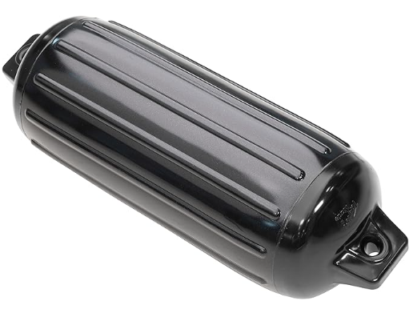
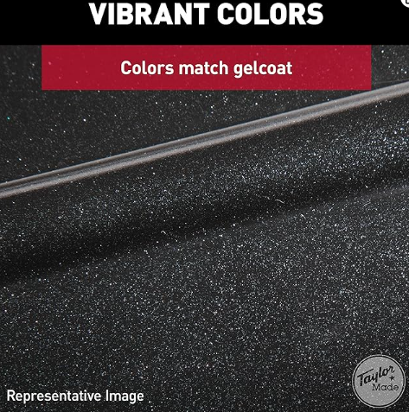
CHALLENGE #6 Shore Deployment
Navigate to the Black Buoy which signifies the recommended shore deployment area
Deploy a student designed object that is left on the beach within the defined area
To receive full points the object must remain on the beach under its own capability after deployment

Slide 12
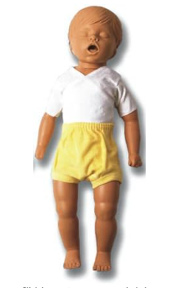
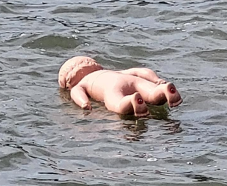

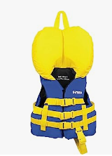
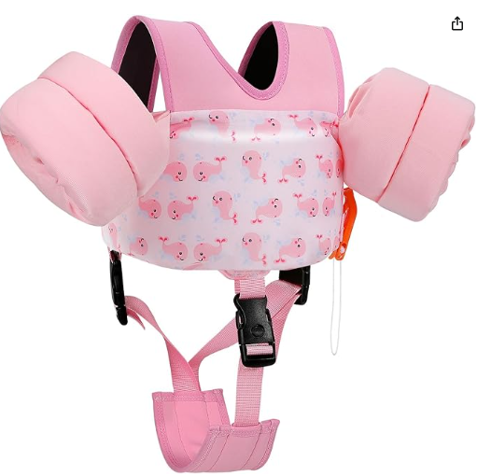
CHALLENGE #7 Search & Rescue
  Find & Retrieve a floating infant
  Scoring
    Retrieve the object and the object stays in the water will have “Value 1”
    Full removal of the object from the water will have “Value 2”
    Any damage to the object will result in decreased points
    Retrieval process must be deemed safe for retrieving a human
https://www.amazon.com/Rescue-Billy-Month-Old-Manikin/dp/B002TECK7G/ref=sr_1_1?crid=OQF17DPPKQYM&keywords=rescue+manikin+billy&qid=1695756643&s=sporting-goods&sprefix=rescue+manikin+billy%2Csporting%2C70&sr=1-1&ufe=app_do%3Aamzn1.fos.ac2169a1-b668-44b9-8bd0-5ec63b24bcb5
    An APPROVED infant life preserver will be on “Rescue Billy” to allow the manikin to float upright

Slide 13

CHALLENGE #8 Sensor Communication
  From Dock
  Communicate wirelessly with the Deployed Sensor from Task #5
  Validate the data to receive additional points

Slide 14
